Slide 1
Shape Memory Alloys: Wing Morphing Technology
Daniel Gracias Guide: Prof. Anirban Patra
25th November `22
IIT Bombay

Slide 2

Report
Link

Slide 3
Shape Memory Behaviour
One-Way Shape Memory Effect Retention of deformed state on removal of load followed by recovery of original shape on heating
Two-Way Shape Memory Effect ‘Memorization’ of two different shapes corresponding to two different temperatures
Superelasticity Recovery of high strains (up to 8.5%) on removal of load
Notes:
Superelasticity

Slide 4
History
Superelasticity in Au-Cd system discovered in 1932 Arne Ölander
The fundamental phenomena behind the shape memory behaviour reported in 1949-51
Discovery of Nitinol (Ni-Ti, 50 at% Ni) 1962
Cheaper
Safer
Superior Thermomechanical Properties
Notes:
Predominantly used for commercial applications

Slide 5
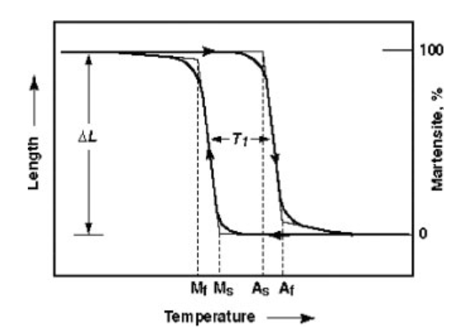
Martensitic Phase Transformation
On cooling Austenite, Martensite formation starts at M_{s} and is completed at M_{f}
On reheating, Austenite formation starts at A_{s} and is completed at A_{f}
Hysteresis
M_{f} < M_{s} < A_{s} < A_{f}
Typical Behaviour of SMAs under constant stress
D.E Hodgeson; Shape Memory Applications, Inc; www.sma-inc.com
Notes:
Hysterisis: dependence on previous state. Fatigue

Slide 6
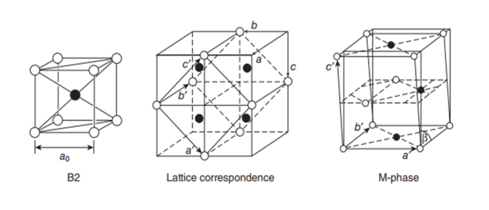
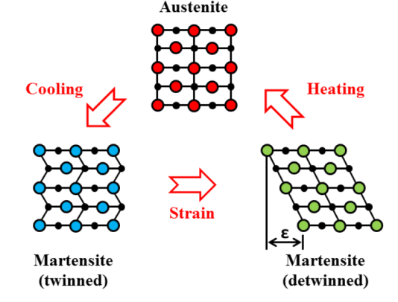
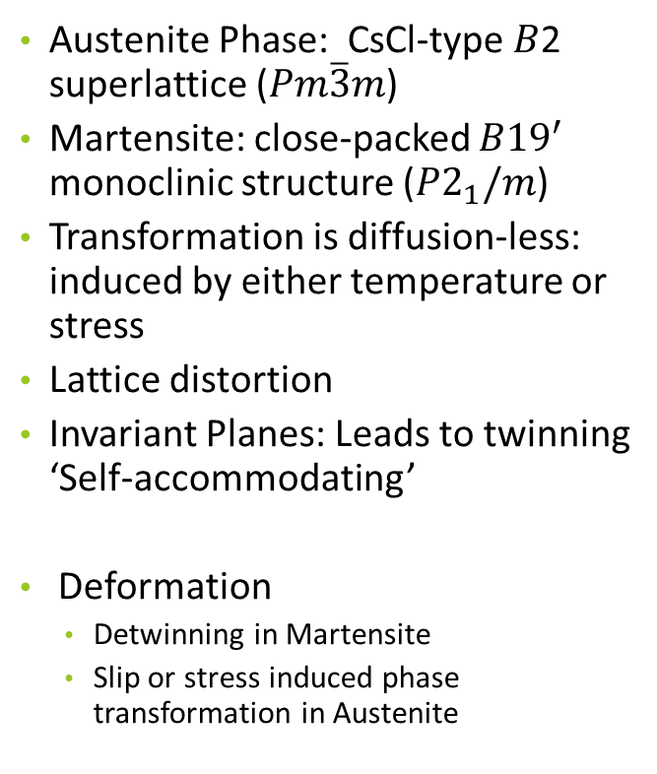
Martensitic Phase Transformation
Austenite Phase: CsCl-type 𝐵2 superlattice ($Pm\overline{3}m$)
Martensite: close-packed $B{19}^{′}$ monoclinic structure ($P2_{1}/m$)
Transformation is diffusion-less: induced by either temperature or stress
Lattice distortion
Invariant Planes: Leads to twinning ‘Self-accommodating’
Deformation
Detwinning in Martensite
Slip or stress induced phase transformation in Austenite
H Miyazaki, H.Y Kim, ‘Basic characteristics of titanium– nickel (Ti–Ni)- based and titanium–niobium (Ti–Nb)-based alloys’
S Barbarino, E I Saavedra Flores, R M Ajaj, I Dayyani, M I Friswell, ‘A review on shape memory alloys with applications to morphing aircraft’ , ‘Smart Materials and Structures’, 23 (2014)
Notes:
Instantaneous change; maintains macroscopic shape

Slide 7
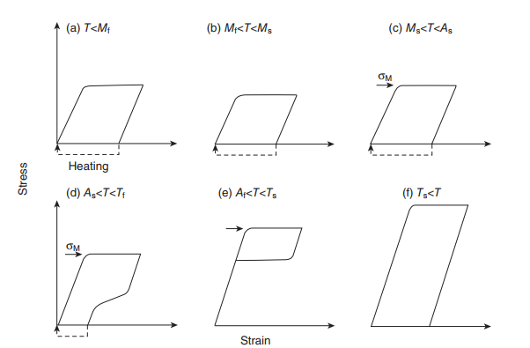
Thermomechanical Behaviour
One way SME: no macroscopic shape difference between twinned martensite and austenite. Heating deformed martensite to A_{f} results in reversion to original shape (a)
Superelasticity: In temperature range A_{f} <T< T_{s,} deformation is via stress induced martensitic transformation. Since austenite is the stable phase, reversion to original shape
Schematic Stress-Strain Behaviour in Various Temperature Ranges
H Miyazaki, H.Y Kim, ‘Basic characteristics of titanium– nickel (Ti–Ni)- based and titanium–niobium (Ti–Nb)-based alloys’
Notes:
Deformation behaviour is temp sensitive. 𝑇s is the temperature above which deformation occurs via slip as opposed to martensitic transformation.

Slide 8
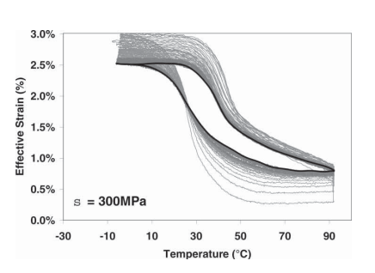
Training
TRIP: TRansformation Induced Plasticity Irrecoverable strain in polycrystals
Higher in the initial cycles, reduces with the number of cycles, eventually stabilizing to zero
Eliminates twinned martensite
Stabilised thermomechanical response: Two way SME
Experimental results for training via isobaric thermal cycling
D J Hartl, D C Lagoudas, ‘Aerospace applications of shape memory alloys’, ‘IMech E’ 221(2007), pp. 535-549

Slide 9
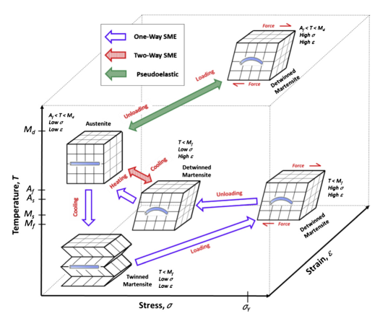
Lagoudas DC. Shape memory alloys: modeling and engineering applications. 1st ed. New York: Springer; 2010

Slide 10
Applications
Advantages
High actuation density
Complex actuation
Thermal Response
Challenges
Actuation Frequency
Accuracy
Temperature control
Efficiency
Fatigue

Slide 11
Applications
Automotive
Linear Actuators: rear view mirror, climate control flaps, etc
Thermal Actuators: engine temperature control, etc
Robotics
Artificial muscles
Microactuators
Biomedical
Dentistry
Stents
Implants
Aerospace
Vibration Dampers
Exhaust Nozzle
Flow mixing chevrons
Wing Morphing

Slide 12
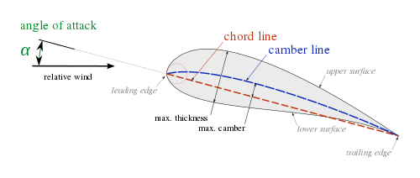
Wing Morphing
Optimisation based on flight regime
Lift to drag ratio
SMA actuators for wing morphing:
Continuous, hinge-less
Lightweight
https://en.wikipedia.org/wiki/Airfoil

Slide 13
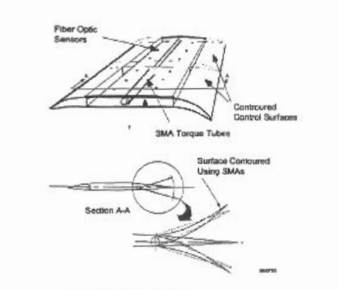
DARPA Smart Wing (1998)
16% Scaled down model of F-18 military aircraft wing
Wind tunnel testing
SMA actuated parameters:
Angle of attack (twist) by means of SMA torque tubes
Provided 5° twist at wing tip
Trailing edge by means of SMA wires
Flap and aileron
J N Kudva et al, ‘Overview of the DARPA/AFRL/NASA Smart Wing Program’ Proceedings of SPIE Conference on Industrial and Commercial Applications of Smart Structures, 1999

Slide 14
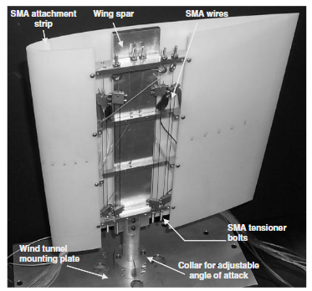
Strelec et al. (2003)
Optimisation tool (Genetic Algorithm): aerodynamic, structural and thermal analysis to converge design; optimise L/D
Nitinol wires for actuation of leading and trailing edge
Wind tunnel tested
Provided trailing edge deflection of 6mm
Strelec J K, Lagoudas D C, Khan M A and Yen J, ‘Design and implementation of a shape memory alloy actuated reconfigurable airfoil’ J. Intell. Mater. Syst. Struct (2003)

Slide 15
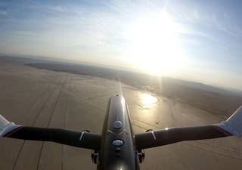
NASA Spanwise Adaptive Wing (2018)
Folding of outboard portions
Up to 70° in both directions
Weighs 80% less than traditional systems with same functionality
Autonomous flight tested
https://www.nasa.gov/centers/armstrong/feature/nasa-tests-new-alloy-to-fold-wings-in-flight.html

Slide 16
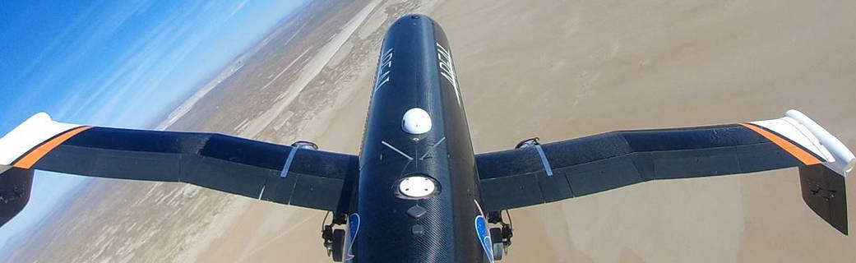
NASA Spanwise Adaptive Wing (2018)
https://www.nasa.gov/centers/armstrong/feature/nasa-tests-new-alloy-to-fold-wings-in-flight.html
https://www.youtube.com/watch?v=9y1kkG2_QpE&t=3s

Slide 17
References
Jaronie Mohd Jani, Martin Leary, Aleksandar Subic, Martin A. Gibson, ‘A review of shape memory alloy research, applications and opportunities’, ‘Materials and Design’, 2013, pp. 1078-1080
H Miyazaki, H.Y Kim, ‘Basic characteristics of titanium– nickel (Ti–Ni)- based and titanium–niobium (Ti–Nb)-based alloys’ (Woodhead Publishing Limited (2011), pp. 15-29
Jose Maria Gallardo Fuentes, Paul Gumpel, Joachim Strittmatter, ‘Phase change behaviour of nitinol shape memory alloys: Influence of heat and thermomechanical treatments’, ‘Advanced Engineering Materials’, Volume 4 Issue 7 (2002), pp. 437-440
D J Hartl, D C Lagoudas, ‘Aerospace applications of shape memory alloys’, ‘IMech E’ 221(2007), pp. 535-549
A.Y.N. Sofla, S.A. Meguid, K.T. Tan, W.K. Yeo, ‘Shape morphing of aircraft wing: Status and challenges’, ‘Materials and Design’ 31(2010), pp. 1284-1292
S Barbarino, E I Saavedra Flores, R M Ajaj, I Dayyani, M I Friswell, ‘A review on shape memory alloys with applications to morphing aircraft’ , ‘Smart Materials and Structures’, 23 (2014)
J N Kudva et al, ‘Overview of the DARPA/AFRL/NASA Smart Wing Program’ Proceedings of SPIE Conference on Industrial and Commercial Applications of Smart Structures, 1999`
Strelec J K, Lagoudas D C, Khan M A and Yen J, ‘Design and implementation of a shape memory alloy actuated reconfigurable airfoil’ J. Intell. Mater. Syst. Struct (2003)
‘NASA Tests New Alloy to Fold Wings in Flight’ - Matt Kamlet (https://www.nasa.gov/centers/armstrong/feature/nasa-tests-new-alloy-to-fold-wings-in-flight.html)

